Slide 1
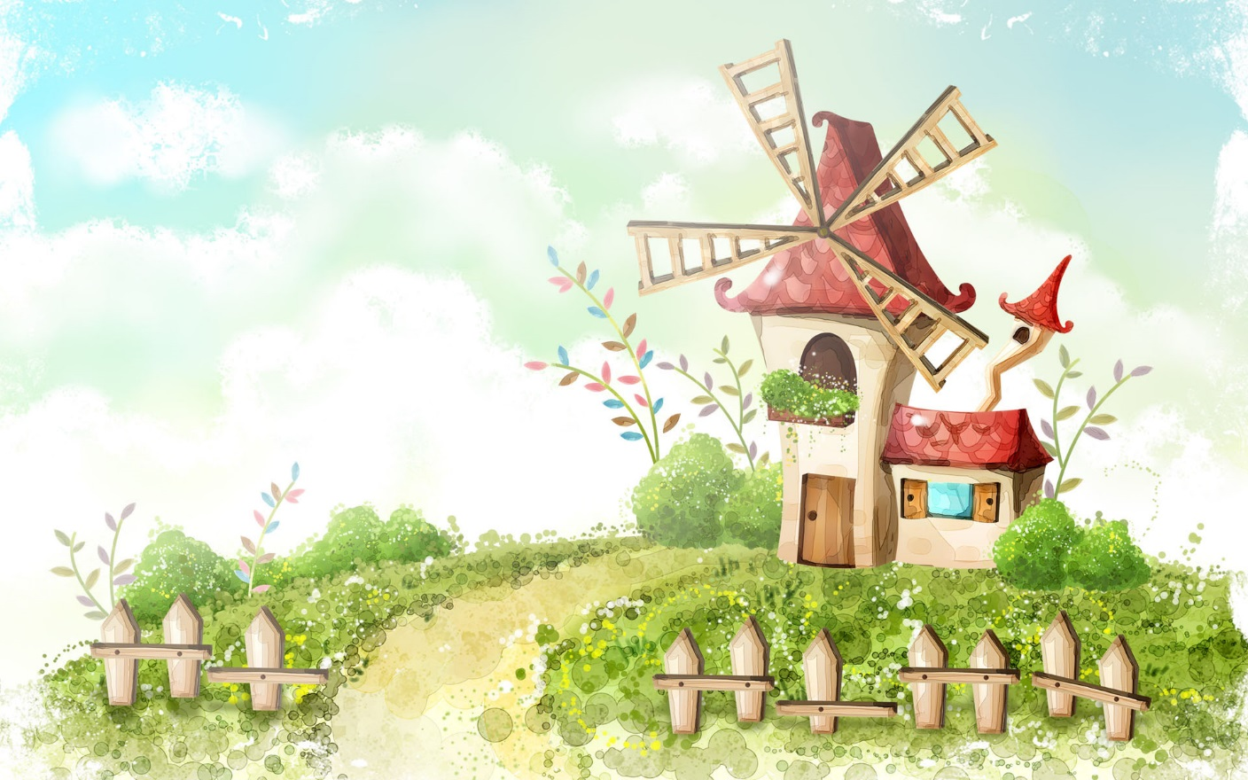
HELLO EVERYONE !!!
ENGLISH 8

Slide 2
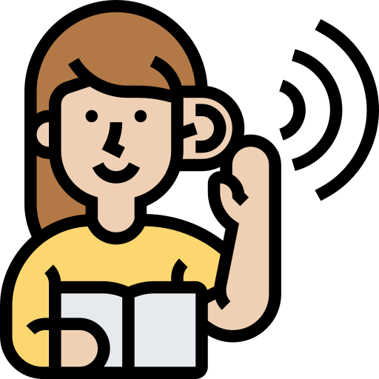
Unit
6
LIFESTYLES
LESSON 6: SKILLS 2

Slide 3
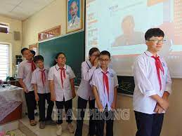
* WARM-UP
- T shows a sentence to the first students of all groups. These students must quickly whisper the sentence to their teammates in order. The last member of each team writes the word on the board. The fastest student writes the correct word earns 1 point for the team.
WHISPERING

Slide 4
* WARM-UP
1. I don’t like studying online
2. Modern technology is greatly changing our lifestyle
WHISPERING
3. Modern technology sometimes causes us problems.

Slide 5
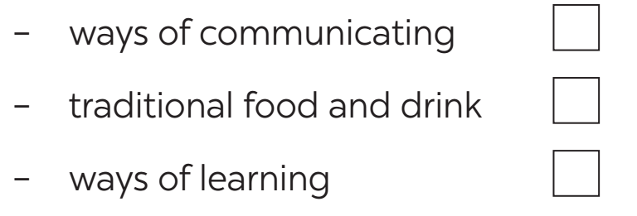
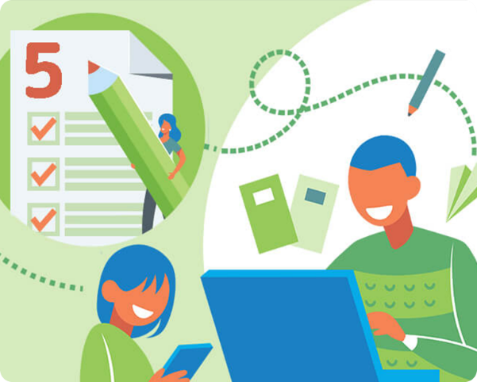
I. LISTENING
1
﻿Work in groups. Which of the following do you think is more influenced by modern technology? Tick (﻿✓) your choice(s).
✓
✓

Slide 6
I. LISTENING
2
﻿Listen to the conversation and tick (✓) T (True) or F (False).
 | T | F
1. When Mai was studying online, the power went oﬀ.
2. Chris likes studying online as it’s convenient.
3. Mai says it’s easy to concentrate when learning online.
4. Chris disagrees that technology improves friendship.
5. Mai thinks technology is changing our way of learning and working.
✓
✓
✓
✓
✓

Slide 7
3
﻿Listen again and choose the correct answer to each question.
1. The talk is generally about ______.
A. the impact of modern technology
B. the good points of online learning
C. the weak points of online learning
2. Both Mai and chris think that modern technology is ______.
A. changing greatly
B. changing our lifestyle
C. entertaining us

Slide 8
3
﻿Listen again and choose the correct answer to each question.
4. Mai wants to go to class because ______.
A. online learning doesn’t work for her
B. she likes to get up early
C. she wants to interact with her teachers and friends
5. Which of the following is true?
A. Mai and chris are classmates.
B. Mai and chris have similar ideas about online learning.
C. Mai thinks online learning has some weak points.

Slide 9
Tapescript
(Mai is having a video call with her penfriend in Singapore-Chris)
Chris: Hi, Mai. How’s everything?
Mai: Not bad. We still have lessons online every day. But this morning, when we were studying the power went off suddenly.
Chris: Really? Modern technology sometimes causes us problems.
Mat: Yeah... By the way, do you like studying online?
Chris: Well, yes. It's convenient and comfortable. You don't have to get up early and get dressed for class.
Mai: But it's difficult to concentrate. And I still want to go to class. I want real Interaction with my teachers and friends.
Chris: Yeah... and learning online all day long causes us headaches and sore eyes.
Mai: Sure. And do you think that modern technology is greatly changing our lifestyle?
Chris: Yes, technology changes the ways we communicate with others.
Mat: And it improves our friendship because it's easy to keep in touch with people living far away.
Chris: Certainly.
Mai: Technology is also changing how we live and work.

Slide 10
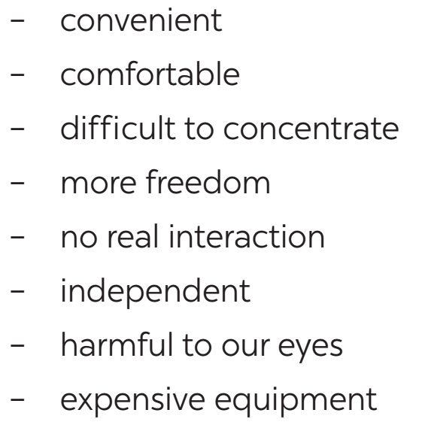
II. WRITING
4
﻿Look at the list below. Put the ideas about online learning in the correct columns.
ADVANTAGES | DISADVANTAGES
﻿- convenient
- comfortable
- more freedom
- independent
﻿- difficult to concentrate
- no real interaction
- harmful to our eyes
- expensive equipment

Slide 11
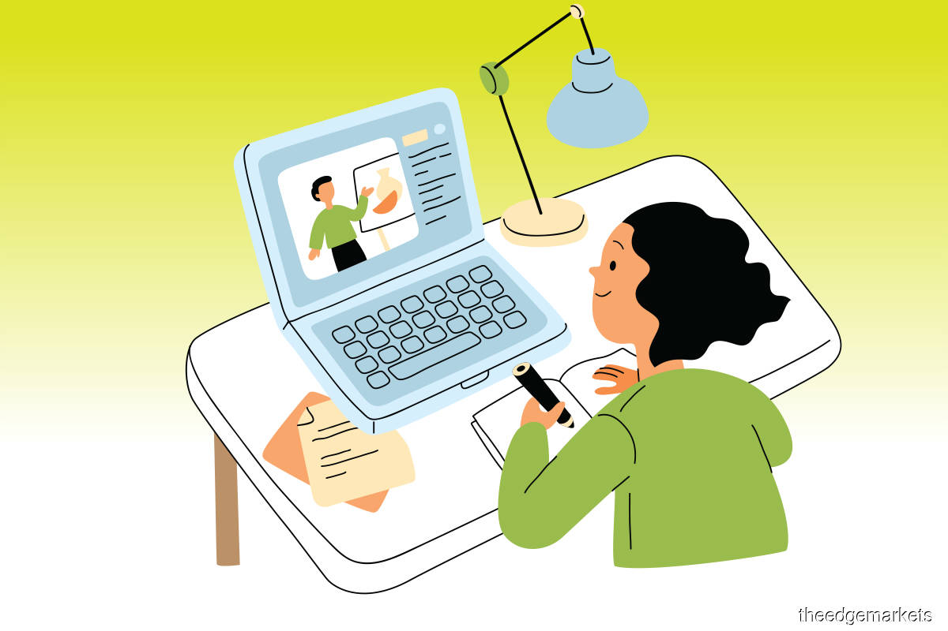
II. WRITING
5
﻿Write a paragraph (80 – 100 words) about the advantages OR disadvantages of online learning. You can refer to the listening and the ideas in 4.
Online learning is becoming more and more popular, but it has several disadvantages. …………………………………………………………………………………………………………………………………………………………………………………………………………………………………………………………………………
……………………………………………………………………………………………………………………………………
……………………………………………………………………………………………………………………………………

Slide 12
II. WRITING
5
﻿Write a paragraph (80 – 100 words) about the advantages OR disadvantages of online learning. You can refer to the listening and the ideas in 4.
* Suggested answer: Online learning is becoming more and more popular, but it has several disadvantages. Firstly, it is very difficult for students to concentrate as they lack face-to-face interaction with their teachers and friends. Secondly, looking at the screen constantly is harmful to students’ eyes, and it causes tiredness, so it is not easy for students to work for too long. Thirdly, working online needs expensive equipment, such as a computer or laptop as well as Internet connection. For these reasons, I prefer going to school and having offline lessons, so that I can meet my teachers and friends every day.

Slide 13
* CONSOLIDATION
What have we learnt in this lesson?
Listen to someone’s opinion about the impact of modern technology
Write a paragraph about the advantages or disadvantages of online learning

Slide 14
* Homework
Learn by heart all the words.
Do exercises in the workbook.
Prepare for Lesson 7 – Looking back & project.

Slide 15
Thank you!
Goodbye!

